Slide 1

Innovate AI with Hitachi Vantara
Hitachi iQ 101
Customer Presentation

Slide 2




Current Market
Democratization of AI
Increased accessibility
Open-Source advancements
Unlimited potential
AI Saturation
Increased focus on ethics
Platform lock-in
Confusing offerings & shadow AI
Enterprise Readiness
Responsible AI
Robust Security & Compliance
Ecosystem Integration
Notes:
Current observation of the market, based on OpenAI's efforts
ChatGPT has lead to the democratization
Increased availability of AI capabilities
Anyone w/ a laptop and who knows about an API can build an AI app
It has created unlimited potential
Through ChatGPT's success, others have jumped on to capture
Microsoft w/ Copilot
Google w/ Gemini
And modality specific platforms like Midjourney, etc.
Platform lock in, like the cloud is happening w/ AI - use cloud jump-in example
Stability.AI lack of stability. $5M USD revenue, $30M USD /qtr spend - they are closing up.
VC Might save them
Confused customers, but most importantly, Shadow AI
Customers need to filter through the noise & transition from Cat pictures to a platform that will fundamentally change how our customers operate
Ensure that AI is used responsibly, even beyond the model selection & data choices, but into how it transforms business & the least risky way possible
And understanding not only the data sources, but the upstream & downstream platforms that become dependent on these systems.

Slide 3




Customer Top Challenges when Adopting AI
Need to update from DO deck
Business Challenges
Data Challenges
Infrastructure Challenges
Operational Challenges
Notes:
Current observation of the market, based on OpenAI's efforts
ChatGPT has lead to the democratization
Increased availability of AI capabilities
Anyone w/ a laptop and who knows about an API can build an AI app
It has created unlimited potential
Through ChatGPT's success, others have jumped on to capture
Microsoft w/ Copilot
Google w/ Gemini
And modality specific platforms like Midjourney, etc.
Platform lock in, like the cloud is happening w/ AI - use cloud jump-in example
Stability.AI lack of stability. $5M USD revenue, $30M USD /qtr spend - they are closing up.
VC Might save them
Confused customers, but most importantly, Shadow AI
Customers need to filter through the noise & transition from Cat pictures to a platform that will fundamentally change how our customers operate
Ensure that AI is used responsibly, even beyond the model selection & data choices, but into how it transforms business & the least risky way possible
And understanding not only the data sources, but the upstream & downstream platforms that become dependent on these systems.

Slide 4
AI Infrastructure Demands and Data Usage
Question text: What are your organization’s criteria when evaluating and selecting data storage vendors for generative AI applications? (Percent of respondents, N=800, multiple responses accepted)
Question text: Which of the following statements best reflects your organization's infrastructure preference when deploying generative AI solutions? (Percent of respondents, N=800)
35%
33%
78%
Reliability
On-Premises
Flexible, Safe, Efficient
Want reliability and availability of solutions with minimal downtime
Cited use of on-premises infrastructure for building and using GenAI solutions.
Want hybrid cloud deployment options, efficient backup and recovery, and competitive pricing with flexible licensing
48%
86%
Question text: Which of the following statements aligns most closely with your organization's strategy for leveraging its own data in generative AI models between retraining models or utilizing retrieval-augmented generation (RAG) techniques? (Percent of respondents, N=800)
Question text: Which of the following statements best characterizes your organization's approach to data used for training generative AI models? (Percent of respondents, N=800)
RAG Use
Internal Data
Will primarily or predominantly rely on internal data for training GenAI models
Will lean on retrieval-augmented generation to some extent to incorporate enterprise data
Enterprise Infrastructure for Generative AI: (hitachivantara.com)
Notes:
#1 Reliability
#2 Flexible, Safe, Efficient

Slide 5
Sentiments Around AI Readiness
McKinsey
Gartner
According to a 2023 McKinsey survey, 66% of organizations are still in the researching or piloting phase of AI adoption, indicating a substantial need for guidance on moving forward effectively with AI initiatives.
According to a Gartner survey, 55% of organizations that have deployed AI take an AI-first strategy. However, a significant number of companies struggle with these initial steps, particularly in discovering high-impact projects and ensuring they align with strategic business goals.
KPMG
The Register
A KPMG survey found that many executives feel unprepared for immediate AI adoption, with a majority still in the early stages of implementation despite recognizing AI's potential for significant business impact.
Many organizations experience difficulties due to the complexity of integrating AI into existing workflows and the high initial costs associated with AI projects. This often leads to a situation where only a small percentage of AI initiatives deliver substantial returns on investment
5
5
Notes:
Between the market reports & the capabilities that some of these external platforms have shown, customers have an expectation of what AI can do for them.
The discovery of new innovations & improvement of revenue streams.
Better utilization of employee time, through copilots, etc.
Reduced cost and complexity, bringing in improved efficiency
These expectations are not unrealistic; however the current reality is customers...
Have no clear starting point // #1 topic is "what are the use cases"
There is a serious lack of in-house talent or expertise & sourcing talent can be quite expensive // Air Canada Example
Just like the cloud 10 years ago, the cost to do AI can be quite misleading. API calls, infrastructure, etc. This all can become quite cost prohibitive when not done in a responsible fashion

Slide 6
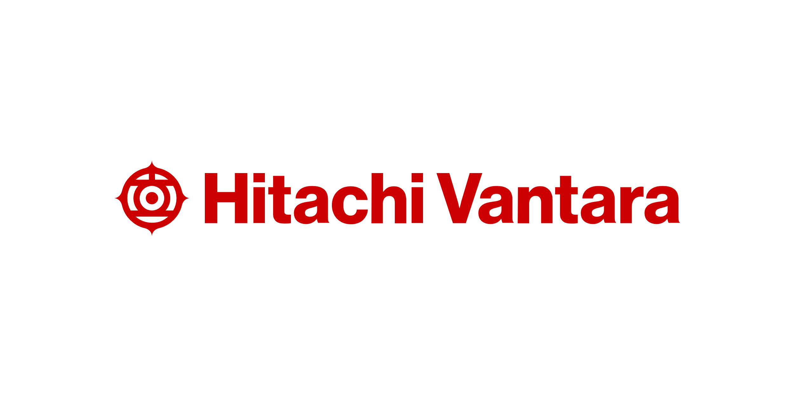

Our Strategic Approach
Empowering Customer Success with AI

Slide 7



Industry Leaders Unite to Advance AI
  Leader in data infrastructure technology & solution frameworks
  Leader in Artificial Intelligence Computing
DELIVERING CUSTOMER VALUE THROUGH STRATEGIC PARTNERSHIPS
  Leader in industrial and operational technologies
Notes:
The intent for this slide is to show the strategic partnership between the three organizations & the creation of an AI Industry Powerhouse.
Log
HCMA_Vendor Brand Guide_1_22.indd (hitachicm.us)
os & Brand Guidelines | NVIDIA

Slide 8




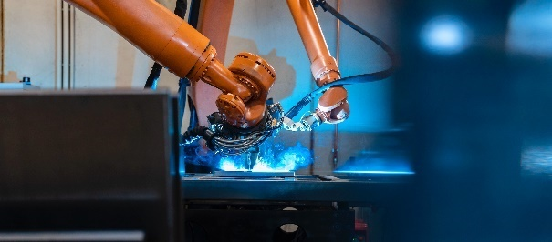

Accelerating Transformation Across Industrials
Leveraging Hitachi’s 110+ years of domain expertise
Finance
Energy
Transportation
Fraud Detection Systems
Customer 360
Algorithmic Trading
Smart Power Grid
Energy Planning
SCADA Cybersecurity
Autonomous Drive
ADAS
Predictive Maintenance
Media & Entertainment
Manufacturing
Healthcare
Manufacturing
Healthcare
Streaming Platforms
Render Farms
Multiverse
Process Automation
Smart Manufacturing
Predictive Maintenance
Gene Research
Genome Mapping
Precision, Remote Medicine
Notes:
This is about Hitachi Vantara’s ability to understand more than just how platforms or products work, but about their pedigree as an organization that for the last 110+ years has built things.

Slide 9













The Sum Of All Parts
Hitachi's End-to-End capabilities enabling our clients AI journey
Execution
Domain
Experts
Digital
Engineering
Integration
RunOps
Data Prep
Visualization
Cloud, Platform, & Data Services
Hitachi Energy
Hitachi Rail
GlobalLogic
Hitachi R&D
Hitachi Digital Services
Pentaho
Hitachi Vantara
Hitachi, Ltd.
Notes:
But this is a sum of all parts equation. It's the execution path through Hitachi Vantara into the market, bringing in our internal capabilities AND the capabilities of Hitachi’s partners and their other Hitachi Digital & Domain Bu's

Slide 10

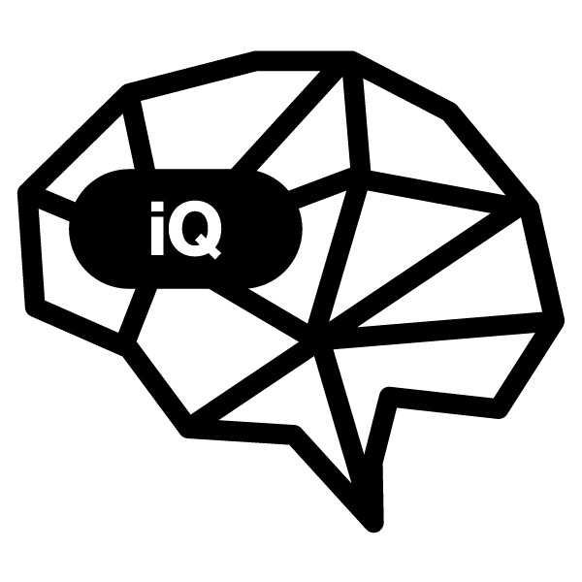



AI Readiness with Hitachi iQ
Business Readiness
AI Discovery Service for Hitachi iQ to determine the right AI pipelines and workloads to drive business growth with fast time-to-value.
Infrastructure Readiness
Hitachi iQ for fast, scalable, cost-optimized, reliable infrastructure with trusted, validated blueprints to simplify deployment, management and support.
Data Readiness
Intelligent data management to improve data selection, quality, preparation, curation, security, movement, and governance.
Operational Readiness
AI solutions for industries and applications that combine tools, technologies, platforms and frameworks to standardize the toolkit and prepare for evolving needs.
CONFIDENTIAL – For use by Hitachi Vantara employees and other audiences under NDA only.

Slide 11
Innovate AI with Hitachi Vantara
Hitachi iQ

Slide 12
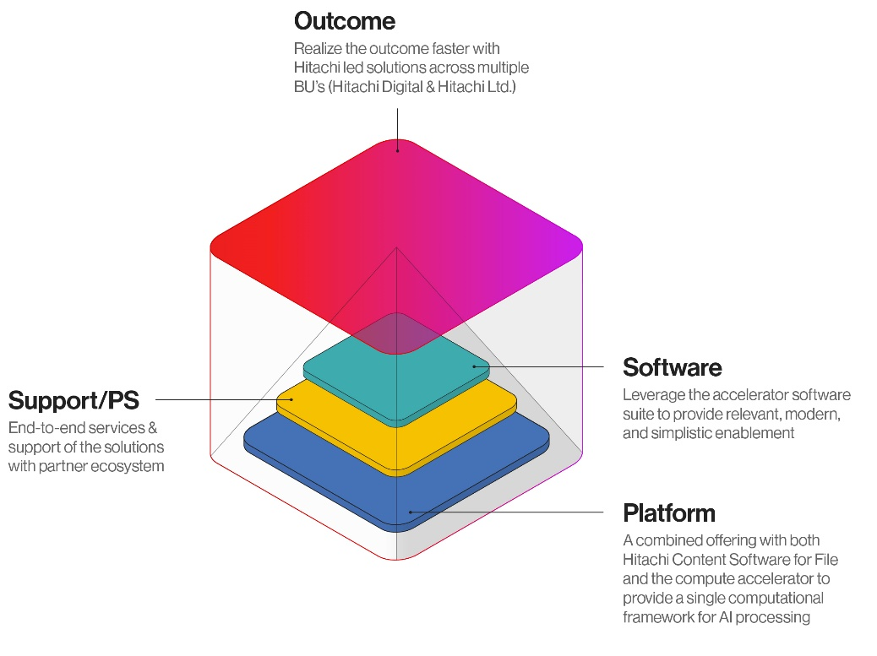

Discover Hitachi iQ
“The tailored AI solutions suite designed for industrials and businesses committed to AI emergence. Empower your organization to automate processes, accelerate time-to-insights, and unlock innovation.”
Outcome
Realize the outcome faster with Hitachi led solutions across multiple BU’s (Hitachi Digital & Hitachi Ltd.)
Software
Leverage the accelerator software suite to provide relevant, modern, and simplistic enablement
Support/PS
End-to-end services & support of the solutions with the partner ecosystem
Platform
A combined offering with both Hitachi Content Software for File and the compute accelerator to provide a single computational framework for AI processing
Notes:
That’s not all Hitachi Vantara has done, in March, they introduced their Hitachi iQ brand portfolio which combines industry leading offerings from NVIDIA with their high-performance parallel filesystem and object storage platforms. This new AI-ready infrastructure solution accelerates GPU workloads by over 20x, providing the fastest time to insight and our massive scale, ultra dense object storage provides exceptional economics for AI platforms at scale. iQ goes beyond basic integration and testing by layering industry specific capabilities on top of the AI solution stack, so outcomes can be more specific and relevant to an organizations business. Hitachi has partnered with industry AI leader NVIDIA and leader in OT Hitachi along with other Hitachi business units (such as Energy, Rail and Digital Services) to innovate on solutions together. There will be more to come throughout the year as Hitachi’s unstructured data solutions are key strategic elements in their AI solutions now and in the future.

Slide 13
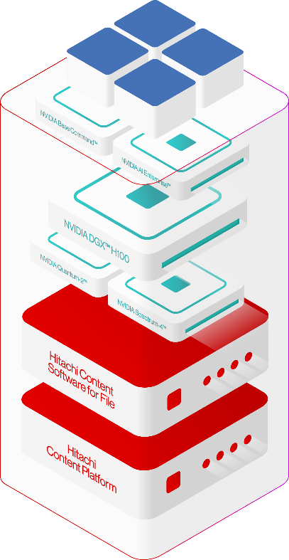
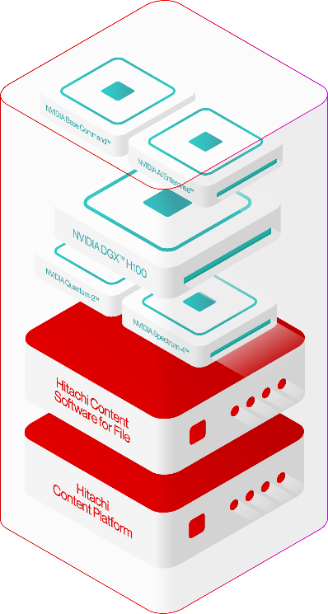
Hitachi iQ
Creating the AI-Ready
AI-Ready Infrastructure
AI-Ready Solutions
Benefits
Meet performance, scale, efficiency, integration, and reliability demands.
Single vendor approach
  Reliable infrastructure
  Reference architectures
  Easy-to-use microservices with enterprise-grade security, support, and stability
Hitachi iQ with NVIDIA HGX™
NVIDIA DGX BasePOD™ certified solution meets the criteria of the "Best" category.
Scale compute and storage independently
Improve economics and sustainability
Benefits
Realize faster outcomes with Hitachi led solutions across multiple BU’s (Hitachi Digital & Hitachi Ltd.)
Outcome-led design
Engineered with Hitachi & NVIDIA Solutions
  Long history of domain expertise in industries such as rail, energy, manufacturing
Accelerated integration based on a pre-built foundation
Bespoke customization & delivery
Notes:
Hitachi Vantara’s AI portfolio is made up of both the infrastructure & the solutions.
Today they are are aligned w/ NVIDIA & supporting this ecosystem. But in the future, as the market evolves, Hitachi is open to support new accelerators or GPU providers
But the solution side is what separates Hitachi from everyone else. It's how Hitachi enable AI. In some cases co-developed w/ NVIDIA, but in other cases done w/ Hitachi’s partners
The point is, Hitachi Vantara are taking steps to create tangible, realistic outcomes powered by AI. Packages in NVIDIA aligned capabilities, like NIMS.
Created as a foundation, but then customized to meet the bespoke needs of each of our customer.

Slide 14

Hitachi iQ AI-Ready Infrastructure with NVIDIA DGX or HGX
AI Software Stack
NVIDIA AI Enterprise
Enterprise-class platform for AI training
End-to-End software for accelerated AI pipelines
Production grade pretrained AI models
Accelerated Compute
Fully integrated hardware and software solution on which to build your AI Center of Excellence
Proven reference architectures for AI infrastructure delivered with Hitachi's leading storage technology
Switching
400Gb Ethernet & NDR InfiniBand Connectivity
Highly scalable & self-healing network capabilities
High-speed, extremely low-latency, and scalable networking
High-Performance Parallel Filesystem
Accelerated filesystem to match the mixed AI workload
Modern consumption improving AI workloads (NVIDIA GPUDirect®, POSIX, S3)
Latest generation platform to support the highest concentrated workloads
Native data offloading capabilities to support better economics at scale
Scale-out Object Storage Tier
Object storage density to provide best storage economics at density
Erasure coding protection designed for large scale volumes of data
Data reduction & compression for ultimate capacity efficiency
Notes:
Link to AI Enterprise details: NVIDIA AI Software Platform for Enterprise
automatically manages tiering of data between high-performance, NVMe-based storage, and low-cost object storage

Slide 15
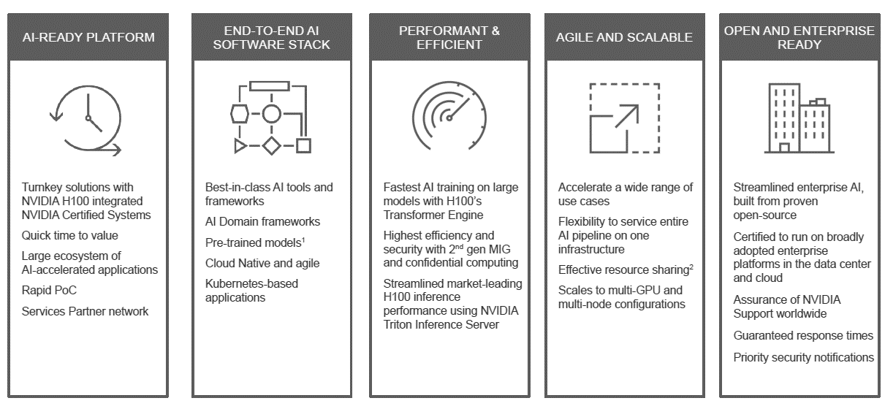
NVIDIA H100 and AI Enterprise
Notes:
Generative AI can provide tremendous value for enterprises. However, enterprises face challenges which are holding back production AI deployments. NVIDIA AI Enterprise is a Cloud Native Platform for AI Solutions that addresses the challenges.
It provides the fastest path to production.
It includes complete AI stacks delivered as a microservice in a container. These provide ease of use with control and optimized performance. There are microservices for many domains, enabling you to deploy NVIDIA, community and custom models on any infrastructure. NVIDIA provides workflows, which are prepackaged reference designs to rapidly deploy end-to-end AI solutions.
It is Enterprise-Grade
NVIDIA AI Enterprise can greatly reduce TCO, with up to 5x cost savings. It assures software security and stability, with proactive security assessments and flexible software branches for all deployments. It includes Enterprise services to ensure customer success.
It runs everywhere
NVIDIA AI Enterprise is supported on all NVIDIA-Certified Systems, as well as all major cloud platforms and hosted Kubernetes services.

Slide 16
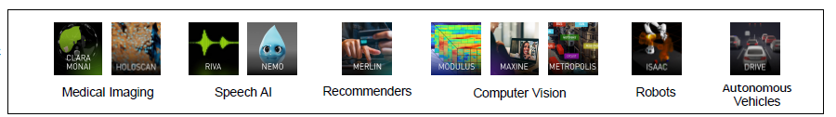
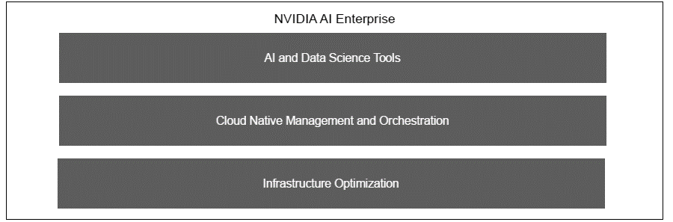
NVIDIA AI Platform
Domain-Specific Frameworks
Development and Deployment Software
Notes:
Link to AI Enterprise details: NVIDIA AI Software Platform for Enterprise
automatically manages tiering of data between high-performance, NVMe-based storage, and low-cost object storage

Slide 17




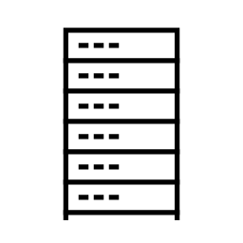


NVIDIA AI Enterprise - NIM for Enterprise AI
Ease of Use with Control and Optimized Performance
NVIDIA NIM
Inference microservices
Speed time to market with prebuilt, continuously maintained microservices
Boost accuracy by tuning custom models from proprietary data sources​
Deploy anywhere with security and control
of AI applications and data
Empower developers with the latest
AI models, standard APIs and enterprise tools
Deploy in production with API stability,
security patching, and enterprise support​
Optimized for greatest throughput
to maximize TCO
Cloud Data Center Edge Workstation
Notes:
NVIDIA NIM is essentially the "easy" button for deploying models with enterprise robustness anywhere – cloud, data center, edge, or workstation. NIM delivers ease-of-use, control, and optimized performance. Specifically, NIM can:
Speed time to market due to prebuilt microservices
Boot accuracy by models from proprietary data sources
Provide the flexibility to deploy anywhere with security and control
Deliver the latest AI models, standard APIs, and enterprise tools to developers
Address production deployment concerns including API stability, security patching, and enterprise support
Optimize for greatest throughput resulting in improved TCO.

Slide 18
AI Your Way
Extracting Value From AI

Slide 19
Popular Business Uses for AI
Question text: What are the potential enterprise use cases driving your organization’s investment in generative AI solutions? (Percent of respondents, N=800, multiple responses accepted)
37%
36%
31%
Process Automation & Optimization
Predictive Analytics
Anomaly Detection
27%
25%
15%
Product Design & Customization
Personalized Recommendation Systems
Co-Pilot/Agent Assist
Enterprise Infrastructure for Generative AI: (hitachivantara.com)
Notes:
General Purpose AI Use-Cases
The possibility of AI and Generative AI in the market is endless. The industry is using this for everything from creating art and graphic design elements to writing code and generating marketing tag lines. The use-cases are endless.
These popular use-cases can be used to provide immediate benefit to any organization.
Whether you are just getting started or are far along your AI journey, these general-purpose use cases automate business processes and operations and to deliver tailored customer experience.
Customer Service Voice Assistant: Customer services assistance revolutionizes customer service with its advanced voice recognition technology, offering real-time responses and personalized assistance. These virtual assistants streamline interactions, ensure customer queries are handled efficiently and with a human touch.
LLM Recommender System: Leveraging the power of Large Language Models, recommender systems deliver highly accurate, context-aware suggestions to enhance user experiences across digital platforms. It personalizes content, products, and services, making discovery seamless and engaging.
Coding & Development Copilot: Copilots can act as an invaluable partner in the development process, offering real-time suggestions, debugging assistance, and code optimization. It accelerates development cycles and enhances code quality by leveraging advanced AI algorithms.
Automated Document Processing and Analysis: This use case applies AI to streamline the processing, analysis, and management of large volumes of documents within enterprise environments. By automating tasks such as data extraction, categorization, and summarization, businesses can significantly reduce manual workloads, improve accuracy, and enhance decision-making processes across various departments like finance, HR, and legal.
Financial Reporting & Accounting: By utilizing large language models that specialize in tax, accounting, cash flow, & more, these solutions can reduce the repetitive tasks that works & consultants are required to do, helping streamline operations & reduce errors for data entry, transaction categorization, & invoice processing.
Edge Inference: Edge Inference technology brings AI computing closer to the data source, minimizing latency and enhancing real-time decision making. It's ideal for applications requiring instant analysis and action, from autonomous vehicles to s

Slide 20
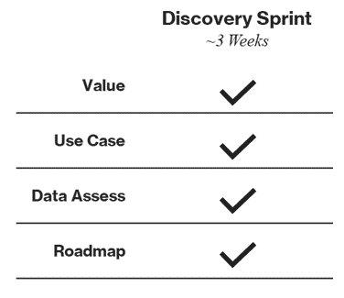
Getting Started with AI
AI DISCOVERY SERVICE FOR HITACHI IQ
Opportunity Analysis
Week 1
Immersion in company priorities, inventory of internal data sources, risk identification, and opportunity prioritization.
Use Case Selection
Week 2
Identify priority use cases to optimize the business and identify a candidate for initial pilot based on value creation opportunity, risk, and data availability.
Planning
Week 3
Plan a proof-of-concept vision, approach, and timeline, aligned to value creation goals, hypotheses to validate, and success criteria. Recommend high-level roadmap for next actions.
Deliverables
Results
Research report on user insights, prioritized AI use cases roadmap, and AI concept documentation and recommendations for roadmap and proof-of-concept
CONFIDENTIAL – For use by Hitachi Vantara employees and other audiences under NDA only.
Notes:
Hitachi iQ for AI Discovery is our enabling service to help our customers start their AI journey.
Capturing our decades of experience into a formal process that allows for us to start the conversation & use this as an enabler
To further support customers on their AI journey, Hitachi Vantara is also launching a new AI Discovery Service, designed to help customers identify the most valuable AI use cases, assess their data readiness, determine ROI, and create a strategic roadmap for successful AI implementation. Depending on the amount of support needed, customers can select between a range of AI consultative services, ranging from a Discovery program that can last as little as three weeks, to an Advisory and Jumpstart programs that can range as long as 12 weeks and include things like a technology assessment, proof of concept scoping, and production planning.
RESULTS
Research Report
Hitachi creates a research report summarizing all user learnings captured during interviews and workshops with the intent of capturing the main pain points and areas of opportunity.
Use Cases Definition & Roadmap
List of identified use cases relevant to the customer. Prioritization of the use cases organized as a now, near and next vision roadmap.
Concept Documentation & POC Plan
A summary of the top AI business concepts along with a proof-of-concept for an AI enabled solution.

Slide 21

Transportation
Transform to AI Assisted Fleet Management
This firm serves customers globally, offering a range of services including full-service commercial truck leasing, fleet maintenance, rentals, and used truck sales. With a workforce of over 40,000 employees globally, the company operates and maintains a fleet exceeding 450,000 vehicles
CHALLENGES
SOLUTION
BENEFITS
Difficult to diagnose failures and find repair, leading to long diagnosis & repair and faulty repair jobs
Difficult to associate complex fault codes with time to failure leading to increase in breakdowns & complex repair
Cumbersome manual inspection for damage resulting in less accurate inspection & increased financial loss
Automate visual inspection to detect surface damages on trucks
Streamline truck inspections for rental operations using seamless and scalable infrastructure
Integrate unstructured data from natural text complaints, fault codes with structured data from the attributes of equipment
Use machine learning to learn from previous repairs how to recommend a course of repair actions
Modern AI assisted repair & fault detection
Improved financial outcomes through better diagnostics
Higher quality/lower cost processes
Built foundations for other use cases using computer vision
Yard check use case to determine if a vehicle is inside/outside the location

Slide 22

Manufacturing
Transform to AI Assisted Manufacturing
A top Korean multinational manufacturing conglomerate with numerous affiliated business and subsidiaries including electronics, semiconductors, appliances, displays, flash memory, medical equipment and more. Their display manufacturing creates massive amounts of data, and the company turned to Hitachi to solve their data problems and improve their processes.
CHALLENGES
SOLUTION
BENEFITS
Customer needed to implement a real time analytics and data lake platform to support its manufacturing improvement process
Manufacturing process creates massive amounts of IoT and image data that needs
to be collected and analyzed
Customer’s existing system not able to handle current and future needs including GPU integration
A combination Hitachi Content Software for File & Hitachi Content Platform nodes to meet needs for archive, tiering, and performance
Price & performance was able to meet customer’s requirements and were able to demonstrate modern use cases
System deployed and able to integrate GPU workloads
An AI computer vision powered QA process for display manufacturing that was not possible with previous system
System captures multiple image feeds to detect defects in glass anywhere on the assembly line
The system simultaneously logs multiple IoT sensor data streams along the entire manufacturing process for calibration needs
Lower cost, less waste and higher quality products
Notes:
10 Petabytes Cloudscale, 2 Petabytes HCSF
Let’s look at a real-world data problem, and how Hitachi solved it.
This success story is about one of the largest Korean manufacturing conglomerates with business and subsidiaries including electronics, semiconductors, appliances, displays, flash memory, medical equipment and more. The company also engages in services such as advertising, construction, financial services, retail, shipbuilding and semiconductor manufacturing.
The customer needed to implement a real time analytics & data lake platform to support its manufacturing improvement process. Furthermore, the customer had trouble dealing with massive amounts of IoT & image data that need to be collected & processed. The customer’s current storage system composed of Isilon & cloudera system simply could not handle the current & future needs, including GPU integration.
The customer uses image capture software that cameras feed into for the assembly line, the manufacturing process for all their displays. The assembly line software captures images across all cameras for each point in the assembly process for like QA. They want to be able to analyze these image feeds as well as sensor data from manufacturing equipment across the assembly line.
The customers existing Isilon & Cloudera system never really worked for what they were trying to do. Hitachi was able to solve this with a combination of on-prem HCSF & HCP to meet needs for archive, tiering, and performance needs. The system consisted of 19 Nodes of HCSF 2U20 Systems with 64 Core CPUs. The HCP consisted of 15 Cloudscale nodes with 9 s31’s, & VADC load balancer (GPU Nodes were provided by System Integrator, not Hitachi) Hitachi was able to win the deal over Dell EMC by staying within the budget and by demonstrating performance on modern use cases.
The customer now has a functioning AI computer vision QA process for it’s display manufacturing process that simply not possible before. The system can capture and analyze multiple image feeds to detect defects in screen glass while simultaneously logging multiple IoT sensor data streams along the entire manufacturing process that helps with machine calibration.
For this customer, had a previous relationship with customer in other divisions, and were able to get into this division via IT Director/CIO in business unit inside of display and who's responsible for the AI and data science teams.
Customer’s current Isilon & cloudera system not able to handle current & future needs including GPU integration

Slide 23

Manufacturing
High Performance Data Platform with GPUs
A multinational top 10 semiconductor company globally by sales that develops analog chips and embedded processors, digital light processing technology and edu-tech products, such as calculators, microcontrollers, and multi-core processors. They needed a scalable on-prem solution (hw and sw) to replace their existing Hadoop cluster
CHALLENGES
SOLUTION
BENEFITS
Existing Hadoop solution didn’t scale to PBs; Couldn’t deal with outburst of loading jobs.​
Manufacturer had to support new factories; failed to consolidate enterprise and fab data.
In need for a scalable on-premises solution platform (hardware and software) to replace their existing Hadoop cluster
HCSF Solution with SQream with full GPU acceleration was implemented as Hadoop replacement.
High Density Compute
Data Ingest at the Edge and Correlation
AI Implementation Pipeline
Integrated Kubernetes stack for Hybrid Cloud DevOps
Consolidated data platform across all sites​
The platform had to meet requirements of being capable of ingesting, processing, and organizing high velocity data sets.
By layering in GPU acceleration with the SQream software, Customer is also able to benefit from a reduced computational layer while still providing accelerated results
Notes:
Challenges and compelling events
The customer wanted a scalable on-premise solution platform (hardware and software) to replace their existing Hadoop cluster
Solution overview major components
HCSF solution (Weka, SuperMicro, Nvidia, and our partner SQream Software)
Business outcomes and impacts
The platform had to meet TI’s requirements of being capable of ingesting, processing, and organizing high velocity data sets.
By layering in GPU acceleration with the SQream software, TI is also able to benefit from a reduced computational layer while still providing accelerated results
Differentiators over competition
Hitachi Vantara Offered an HCSF platform in a flexible consumption model, all backed by enterprise Hitachi support and service. Hitachi Vantara has 28 Global Service Delivery & Centers
Hitachi Vantara offered an Integrated Stack with best of breed Performance, Reliability, Management, Installation and Support

Slide 24

Here’s What Hitachi Customers Are Saying About Hitachi iQ…
SEAMLESS INTEGRATION/ENHANCED EFFICIENCY
“
Hitachi iQ will provide us with a seamless integration experience, allowing us to maximize efficiency without the need for extensive troubleshooting. It will streamline our processes and enhance reliability across our organization.
Digital Product Manager, Global Storage
Large Insurance Provider
”

Slide 25
AI Innovation with Hitachi iQ
PERSONALIZE YOUR AI
Built to meet the rigors of AI, engineered for industry outcomes, but customized to your needs
“Your AI Your Way”
IMPROVE ACCURACY
Increase quantity and quality of data to improve reliability of results. Identify, classify, transform, move, consolidate and prepare data to get the most value out of AI/ML initiatives
ACHIEVE FASTER INSIGHT
Accelerated architecture delivers massive performance starting at 600GB/s and 22M IOPs resulting in as much as 20x reduction in GPU processing time through better utilization of resources
LOWER TCO
Leverage lower cost, erasure coded, scale out object storage to safeguard data, catalog for re-use and store data long term while optimizing costs
SIMPLIFY TO SCALE
Validated designs and solution blueprints provide the flexibility and scale to rapidly develop; test, and deploy modern applications while adapting to fluctuating customer workload demands

Slide 26
The Hitachi Difference
110+
Years experience in IT & OT
Beginning with the production of electric motor control devices and switchboards circa 1914, after the establishment of Hitachi, Ltd. in 1910.
80%
Efficiency through automation
Versus using disparate systems or manual processes by empowering business users to visualize data and make smarter informed decisions.
20X
Improvement in AI training time
Increase AI research productivity with up to 20X improvement in GPU utilization, extracting value from the GPU quicker.
75%+
Improved ROI of resources
Improve ROI of specialized devices, real-time applications, and reduce workload wall clock time by 75% or more compared to local SSD storage.
> 65%
Storage cost savings
Achieve storage cost savings by more than 65% leveraging shared storage instead of traditional High-Performance Computing or HPC clusters using individual drives.
Notes:
Only Hitachi Ltd. has the in-depth industrial expertise across Energy, Transportation, and more to utilize GenAI to accelerate digital transformation, customer experience, and people’s lives!
Through Hitachi Ltd.'s extensive legacy in improving society, these companies are fueling true industrial impact. Now armed with Hitachi IQ, Hitachi & NVIDIA's impact on society is being extended to fuel further social innovation.
With Hitachi Ltd and Hitachi Vantara, NVIDIA is now able to reach and accelerate innovation across numerous industry verticals.
Unlike other storage vendor engagements with NVIDIA which have focused on general-purpose AI and analytics appliances, Hitachi Vantara is able to harness the vast industrial market knowledge and solution penetration of Hitachi Ltd. companies.
AI Solutions for Industry: Revolutionizing the Industry | Hitachi Vantara
Hitachi Content Software for File | Hitachi Vantara

Slide 27
Thank You

Slide 28
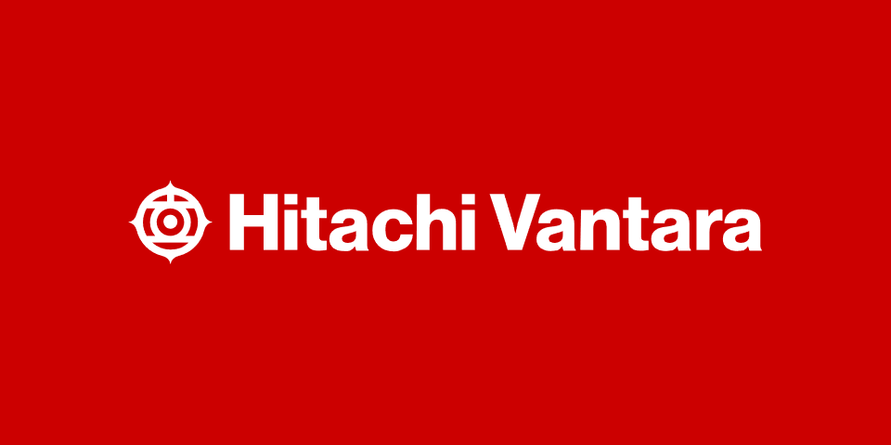
Follow Hitachi Vantara
@HitachiVantara
Hitachi Vantara
@HitachiVantara
@HitachiVantara
Hitachi Vantara
Follow Hitachi Vantara
28
© Hitachi Vantara LLC 2023. All Rights Reserved.
28

